Slide 1


Reproductive Health Lesson #1
Grade 11
PPL30
Adapted and reproduced with permission of Simcoe Muskoka Health Unit

Slide 2
Lesson Content
Overview of the Reproductive System
How Conception Occurs
Brainstorming Activity
Reproductive Health Quiz

Slide 3

Female Reproductive System
©2013 teachingsexualhealth.ca
Notes:
Refer to teacher’s notes for discussion points.

Slide 4
Male Reproductive System
©2013 teachingsexualhealth.ca
Notes:
Refer to teacher’s notes for discussion points.

Slide 5
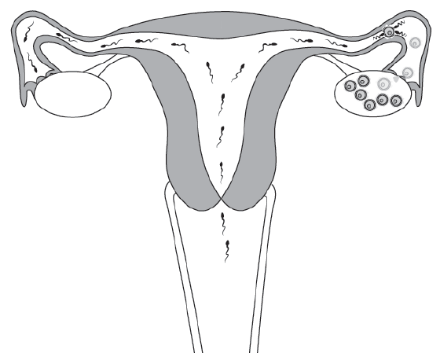
How Conception Occurs
©2013 teachingsexualhealth.ca
Notes:
Refer to teacher’s notes for discussion points.

Slide 6
What factors can influence reproductive health?
Alcohol
Caffeine
Drugs
Education
Environment
Genetics
Friends and family
Folate/folic acid
Weight
Sexually transmitted infections (STIs)
Immunization status
Income
Medications
Exercise
Tobacco
Stress
Nutrition
Notes:
Ask question to class before showing answers and brainstorm suggestions. Hopefully students will come up with some of the points listed here.

Slide 7
Reproductive Health Quiz
Complete quiz by marking true or false
Discussion

Slide 8
Life Plans
Do I want to be a parent some day?
How many children would I like to have?
Who will I talk to if I have questions about my sexual health?
What do I want to be doing next year? In 5 or 10 years?

