Slide 1
Reducing Sexual Risk
Grade 9
PPL10
Adapted and reproduced with permission from Alberta Health Services

Slide 2
Lesson Content
Describe factors that lead to sexual risk
Identify and describe the responsibilities and consequences associated with involvement of sexual relationships
Identify community support services related to sexual health concerns
Describe factors and develop strategies that lead to responsible sexual relationships

Slide 3
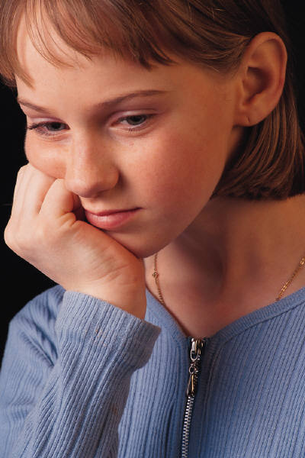
Could it Happen to You??
Notes:
Distribute handout: Could it Happen to you? Part A
Have students complete exercise
Distribute handout: Could it Happen to You? Part B
Have students complete the exercise

Slide 4
Case study 1: Ethan and Olivia
The summer after grade 9, Olivia was offered a job as a youth tennis instructor at a summer camp. Olivia took the job even though she knew it meant being away from her family and friends for weeks at a time.
At camp, Olivia felt lonely. The other girl counsellors had attended that camp for several summers before they became counsellors, and seemed to be in a clique that excluded her. Then Olivia met Ethan. He was a really hot lifeguard, and all the girls wanted his attention. Ethan became really interested in Olivia and asked her out.
Suddenly, the other girls paid attention to Olivia. They included her in their activities and pumped her for information about Ethan. Olivia wanted to be popular, so she decided to go out with Ethan. Everyone would think she was nuts if she didn’t.
Ethan very quickly began to pressure Olivia to have sex with him. He even made it clear he would stop dating her if she refused. One night, after drinking beer and smoking marijuana, Ethan walked Olivia back to her cabin and asked if he could come into her room with her.
Notes:
Read First Case study out loud or have a student volunteer to read out loud.
Ask students questions associated in lesson

Slide 5
Factors to Consider: Case 1
Pressure from Ethan and friends
Wanting to be popular, to belong
Alcohol, drug use
Attraction to Ethan
Readiness for consequences of intercourse
STI protection
Pregnancy prevention
Feeling good about the decision
Alternatives to intercourse
Notes:
Answer to Ethan and Olivia Case 1 question a)

Slide 6
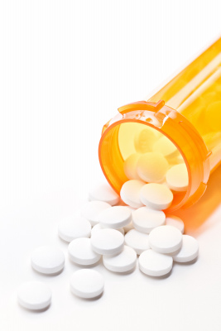
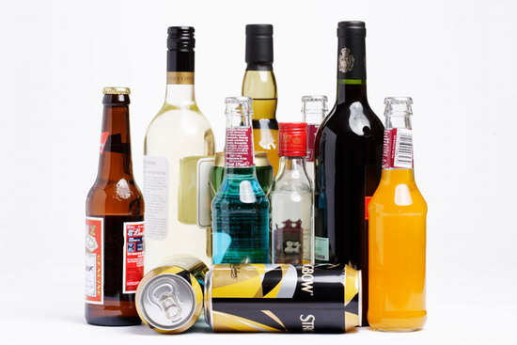
Factors That Increase Sexual Risk
Lonely
Popularity
Low self-esteem
Alcohol and drug use
Peer pressure
Notes:
Answer to Ethan and Olivia Case 1 question b)

Slide 7
Outcomes or Consequences
Pregnancy
STIs
Abusive relationship
Notes:
Answer to Ethan and Olivia Case 1 question d)

Slide 8
Where to go for Help?
Sexual Health Clinics durham.ca/sexualhealth
Oshawa 905 433 8901 or 1 800 314 8533
Pickering 905 420 8781
Port Perry 905 985 4891 or 1 800 314 8533
AIDS Committee of Durham Region aidsdurham.com
Durham Health Connection Line 905-666-6241
The Youth Centre theyouthcentre.ca
Distress Centre Durham distresscentredurham.com
Durham Rape Crisis Centre durhamrapecrisiscentre.com
Durham Region Domestic Violence/Sexual Assault Care Centre dvsacc.com
PFLAG Canada: support and information for people with questions or concerns about sexual orientation and gender identity pflagcanada.ca
Durham CMHA – Canadian Mental Health Association durham.cmha.ca/
Family Health Care Provider
Walk in Clinic
Notes:
Answer to Ethan and Olivia Case 1 question e)
Provide Handout #3 for students to take home as reference

Slide 9
Case Study 2 : Ethan and Olivia
The summer after grade 9, Olivia was offered a job as a youth tennis instructor at the summer camp. Olivia took the job, even though she knew it would mean being away from her family and friends for weeks at a time.
At first, Olivia felt lonely. Although the other girls had attended the same camp for several summers and seemed to be in a clique, Olivia persisted and eventually made a few friends. One evening, Olivia met Ethan. He was a really hot lifeguard and all the girls wanted his attention. Ethan became really interested in Olivia and asked her out.
Ethan was really nice to Olivia and they spend a lot of their free time together. Ethan taught Olivia how to swim and Olivia taught Ethan how to play tennis. They took long walks together and talked about everything! They were practically inseparable and seemed very happy.
At one point during the summer, Olivia and Ethan started talking about having sex. They felt very close to one another and wanted to show each other how much they really cared about one another. They both agreed that if they were to have sex, they would use condoms in order to protect each other from unintended pregnancy and STI. Olivia also decided that the next weekend she had off from work; she would go to a clinic at home and get birth control pills.
Notes:
Read Case Study 2 out loud or have a student volunteer to read out loud.

Slide 10
Factors to Consider: Case 2
Good communication
Equal relationship
Sharing relationship, both contribute
Pleasure
Love
Genuine and mutual care and concern
STI prevention
Pregnancy prevention
Notes:
Answer to Ethan and Olivia Case 2 question a)

Slide 11
Factors That Reduce Sexual Risk
Birth control
Good communication
Healthy relationship
Clear judgement – no alcohol or drug abuse
Positive self-esteem
Notes:
Answer to Ethan and Olivia Case 2 question c)

Slide 12
Additional Factors to Consider
Comfort with own body
Parental expectations
Cultural expectations
Religious expectations
Freedom to say yes or no
Notes:
Answer to Ethan and Olivia Case 2 question 3 b)

